Slide 1
B.TECH ECE FINAL YEAR PROJECT FINAL REVIEW
STACKOVERFLOW ASSISTANT CHATBOT USING NLP
TEAM
17BEC0125 – Jasmine Batra
FACULTY GUIDE
Sankar Ganesh S
School Of Electronics Engineering
Assistant Professor (Senior)

Slide 2

STACKOVERFLOW ASSISTANT CHATBOT A conversational Chatbot that assists with search on the Stack Overflow website

Slide 3
C
O
N
T
E
N
T
S
1. Literature Survey
2. Objective
3. Flowchart
4. Hardware/Software Tools
5. Methodology
6. Results
7. Conclusion
8. Scope for Improvement
9. Timeline
10. References

Slide 4

LITERATURE SURVEY
Authors | Year | Title | Review
N. N. Khin and K. M. Soe | 2020 | Question Answering based University Chatbot using Sequence to Sequence Model | N. N. Khin and K. M. Soe used the Sequence to Sequence model with Attention Mechanism based on the RNN encoder-decoder model to explore ways of communication by neural network Chatbots. This Chatbot is designed for use in the university education sector to answer frequently asked questions about the university and its related details.
B. Setiaji and F. W. Wibowo | 2016 | Chatbot Using a Knowledge in Database: Human-to-Machine Conversation Modeling | B. Setiaji and F. W. Wibowo focused on the machine being programmed with the ability to recognize sentences and make decisions on its own in response to a question. This work employs bigram to calculate sentence similarity, which divides the input sentence into two characters. The higher the score, the more similar the reference sentences are. Chatbot’s knowledge is stored in a database. In relational database management systems (RDBMS), the Chatbot comprises a core and an interface that accesses that core.

Slide 5
LITERATURE SURVEY
Authors | Year | Title | Review
M. Shen and R. Huang | 2018 | A personal conversation assistant based on Seq2seq with Word2vec cognitive map | M. Shen and R. Huang describe how data collected when users conduct conversations using WeChat social network application can be used to enhance people’s lives as well as build a customized Chatbot based on personal conversation history. This work uses a cognitive map based on the word2vec model to learn and store the relationship between each word in the chatting records. A vector in a continuous high-dimensional vector space will be used to represent each word. They used the sequence-to-sequence method (seq2seq) on all pairs of chatting sentences to learn chatting styles.
M.Y.H. Setyawan, R.M. Awangga, and S.R.Efendi | 2018 | Comparison of multinomial naive bayes algorithm and logistic regression for intent classification in Chatbot | M.Y.H. Setyawan, R.M. Awangga, and S.R.Efendi propose a classification method called intent classification on the Chatbot system to determine intent rather than user input. They compare the Naive Bayes and Logistic Regression methods for classifying data and determining the degree of recall, accuracy, and precision of both methods’ evaluation results in this analysis. According to the evaluation results, the Logistic Regression model has a higher degree of recall, accuracy, and precision than the Naive Bayes model.

Slide 6
OBJECTIVE
Building a conversational Chatbot that will assist with search on the Stack Overflow website.
To build a dialogue Chatbot that will be able to:
Answer questions related to programming.
Simulate dialogue and chit-chat on all non-programming related questions.
For programming questions, the Stack Overflow dataset will be used.
For non-programming questions that require a chit-chat mode, a pre-trained neural network engine available from the ChatterBot python library will be used.
The bot will be integrated with Telegram messenger so that we can now talk to this bot in Telegram.

Slide 7
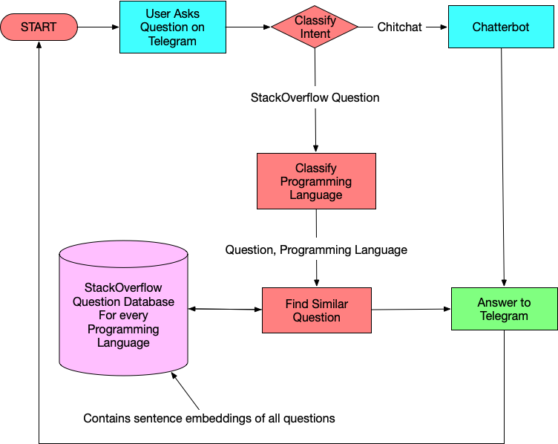
FLOWCHART
Figure 1. Flowchart of our StackOverflow Assistant Chatbot

Slide 8
HARDWARE/SOFTWARE TOOLS
Resources to build our Chatbot
Google Colab to train the model.
A free online cloud-based Jupyter notebook environment used to train and evaluate our model.
Atom to link our model and the bot.
A free and open-source text editor used to establish a connection between our model and the Telegram bot.
Chatterbot library for dialogue (chit-chat) type questions.
A Python library to enable our Chatbot to provide automated responses for chit-chat type questions.
GoogleNews-vectors to convert every question to an embedding.
A pre-trained word2vec model from Google, which was trained on a portion of the Google News dataset (about 100 billion words). In the model, 300-dimensional vectors represent three million words and phrases.
Telegram to instantiate the bot
A cloud-based instant messaging software used as a medium for a user to talk to the bot by creating a Chatbot UI and connecting it to the telegram app back-end, and running our Chatbot logic.

Slide 9
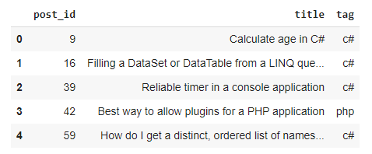
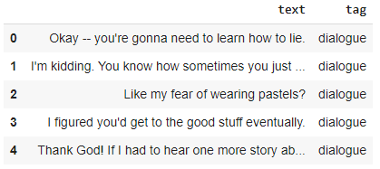
HARDWARE/SOFTWARE TOOLS
Stack Overflow and Dialogues dataset
tagged_posts.tsv — Stack Overflow posts, tagged with one programming
language (positive samples).
Figure 2. A sample of tagged_posts.tsv
dialogues.tsv — dialogue phrases from moves subtitles (negative samples).
Figure 3. A sample of dialogues.tsv

Slide 10
METHODOLOGY
Model Creation (Model_Creation.ipynb)
Our model creates TF-IDF Vectorizers, Intent-Classifier model, Programming Language-Classifier model, and embeddings for each programming language considered here.
Texts are pre-processed, TF-IDF transformations are applied on them, and the TF-IDF vectorizer is dumped.
To create our Intent-Classifier, we first prepare the data for it from dialogues.tsv and tagged_posts.tsv, create features with a TF-IDF Vectorizer and then train a Logistic Regression Model.
To create our Programming Language-Classifier, we first prepare the data for it from tagged_posts.tsv, create features with a TF-IDF Vectorizer and then train a OneVsRestClassifier Logistic Regression model.
Every question is converted to an embedding using pre-trained word vectors (word2vec model) from Google and stored that are categorized by the programming language.

Slide 11
METHODOLOGY
Procedure
1. Import Libraries
Import the required libraries.
2. Read the Data
Read the dataset files and store them as a data frame.
3. Create training data for intent classifier
Concatenate dialogue and Stack Overflow examples into one sample.
Pre-process the texts and split the data into a training set and test set in a 9:1 ratio.

Slide 12
METHODOLOGY
4. Create Intent classifier
Transform the train set and test set into TF-IDF features.
Do a binary classification on TF-IDF representations of texts
Labels will be either dialogue for general questions or stackoverflow for programming-related questions.
Train the intent recognizer using Logistic Regression on the train set
Check out the accuracy on the test set to check whether everything looks good.
Dump the TF-IDF vectorizer and the classifier with pickle to use it later in the running bot.
5. Create Programming Language classifier
Prepare the data for this task and split the data into training set and test set in an 8:2 ratio.
Reuse the TF-IDF vectorizer that I have already created.
Train the tag classifier using OneVsRestClassifier wrapper over LogisticRegression.
Check out the accuracy on the test set.
Dump the classifier to use it in the running bot.

Slide 13
METHODOLOGY
6. Store Question database Embeddings
Load GoogleNews-vectors-negative300.bin, a pre-trained word2vec model from Google.
Each question is converted to an embedding and stored, so we don’t have to recalculate the embeddings for the entire dataset each time.
Whenever a Stack Overflow question is asked, use cosine similarity to find the most similar question.
For each programming language (tag), create a .pkl (pickle) file with two data structures, which will serve as an online search index:
tag_post_ids — a list of post_ids that will be needed to show the title and link to the thread.
tag_vectors — a matrix where embeddings for each question are stored.
7. Given a question and tag, to retrieve the most similar question’s post_id
Load the question’s tag’s .pkl file.
Convert the question to a vector and compute the minimum distance between this vector and tag_vectors (set of vectors) to find the index of the most similar post.
In essence, to have a function that returns the post id of the most similar question in the dataset given that we know the question and the programming language of the question.

Slide 14
METHODOLOGY
Telegram Setup (main.py)
Telegram makes it simple to design a Chatbot UI.
It gives us an access token that we’ll use to connect to Telegram’s back-end using its API and run our Chatbot logic.
Naturally, we’ll need a window to type our questions to the Chatbot, which Telegram provides for us.
Additionally, the Chatbot is powered by Telegram, which communicates with our Chatbot logic and the models created.

Slide 15
METHODOLOGY
Procedure
Set up a bot by talking to the BotFather in Telegram and creating a name/user name for the bot.
I will use main.py to make our Chatbot communicate with Telegram using the access token.
BotHandler class implements all back-end of the bot using Telegram’s API. It has three main functions:
get_updates - checks for new messages sent by the user.
get_answer - computes the most relevant answer to a user’s question using a SimpleDialogueManager class.
send_message – posts the answer computed as a new message to the user.

Slide 16
METHODOLOGY
SimpleDialogueManager class is where we will write our bot logic that fits the pieces together to build one wholesome logic.
All the models and TFIDF objects are instantiated (.pkl files).
A Chatbot is instantiated using ChatterBot and trained on the provided English corpus data for chit-chat type questions.
get_similar_question function - given the question and the question’s programming language (tag), loads the particular tag’s post_ids and post_embeddings from the .pkl file, converts the question to a vector and computes the minimum distance between this vector and post_embeddings (set of vectors) to find post id of the most similar question in the dataset.
generate_answer function - transforms the question using the loaded tfidf_vectorizer and determines the intent of the question. For a dialogue question, it generates a response using ChatterBot. For a programming question, it finds the tag (programming language) and, using the get_similar_question function, generates the thread (Stack Overflow link) of the question that is the most similar as a response.

Slide 17
RESULTS
The bot responds to a programming question with a Stack Overflow link for the question asked and simulates dialogue for a non-programming question.
TFIDF vectorizers have been created and saved as tfidf.pkl in my project repository (resources).
Two classifiers have been created:
Intent-Classifier that will predict if a question is a dialogue question or a Stack Overflow question with a test accuracy of 98.98%. It is saved as intent_clf.pkl in my project repository (resources).
Programming Language (Tag)-Classifier that will predict the language of a Stack Overflow question with a test accuracy of 80.38%. It is saved as tag_clf.pkl in my project repository (resources).
A .pkl file for every programming language (tag) that contains the tag’s post IDs and the embeddings for each question of that tag are stored in my project repository (resources/embeddings_folder).
Telegram has been set up to show how our Chatbot responds to users’ queries.
In the terminal window, we also get a dictionary about the message sent by the user (question) that contains a Unique Chat ID, Chat Text, User Information, etc., which we can use as per our requirements later.

Slide 18
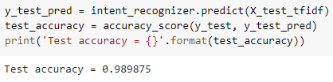
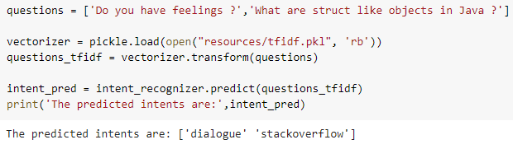
RESULTS
Intent-Classifier
Testing Accuracy
Figure 4. Accuracy of Intent-Classifier
Sample Output
Figure 5. Sample output of Intent-Classifier

Slide 19
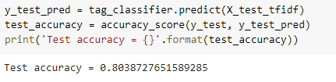
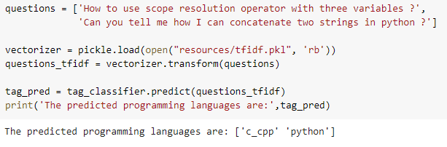
RESULTS
Programming Language (Tag)-Classifier
Testing Accuracy
Figure 6. Accuracy of Programming Language –Classifier
Sample Output
Figure 7. Sample output of Programming Language -Classifier

Slide 20
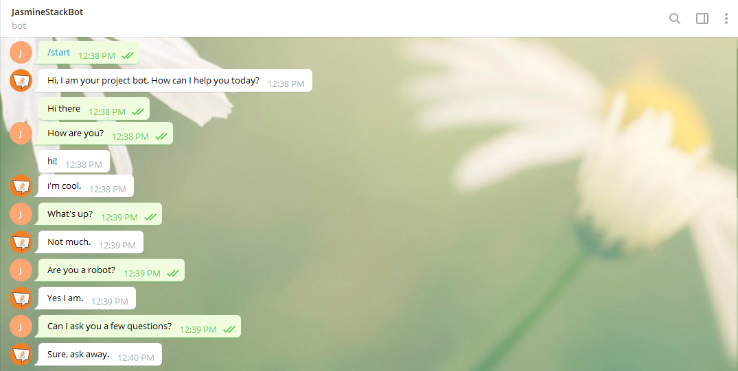
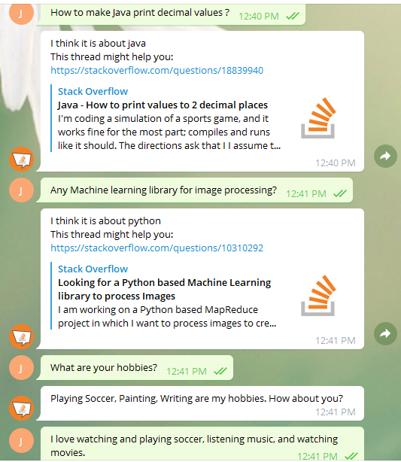
RESULTS
Conversation with the bot in Telegram
Figure 8. Conversation with the bot in Telegram

Slide 21
RESULTS
Sample output of Chatbot
User Text | Intent-Classifier | Programming Language-Classifier | Response
Where are you from? | dialogue | - | I am from where all software programs are from; a galaxy far, far away.
Can I replace plain URLs with links? | stackoverflow | javascript | I think it is about javascript This thread might help you: https://stackoverflow.com/questions/19547008 (How to replace plain URLs with links, with example?)
Are you sentient? | dialogue | - | Sort of.
How to create a static class in cpp? | stackoverflow | c_cpp | I think it is about c_cpp This thread might help you: https://stackoverflow.com/questions/9321 (How do you create a static class in C++?)
How are you doing? | dialogue | - | I am doing well.
Sorting a dictionary in python | stackoverflow | python | I think it is about python This thread might help you: https://stackoverflow.com/questions/7546170 (Sorting a dictionary in python)

Slide 22
CONCLUSION
In this project, I’ve proposed an approach for designing and building an interactive Chatbot that does question-answering.
The proposed approach includes different classifiers, stored question database embeddings, telegram bot handler and their implementations.
Experimental results show that the selected algorithms are in accordance with the implementation of the Chatbot approach with good test accuracies.
Telegram is used as a frontend medium to ask questions to the bot, which then responds back using the trained models in its back-end.
The Chatbot will assist people in searching for solutions to programming questions that they would need (at work or study) and also hold conversations with the user.

Slide 23
SCOPE FOR IMPROVEMMENT
We can increase the accuracy of the classifier, handle edge cases, make it reply faster, or add more logic to handle more use cases to improve on this Chatbot.
For a chit-chat mode, I have used a pre-trained neural network engine available from ChatterBot. We can also use Seq-2-Seq models or train our own models to create such bots.
I’ve used GoogleNews-vectors to convert every question to a vector. We can also use StarSpace embeddings for the same.
In the near future, I plan to extend my work on a large-scale study to answer questions from all domains, i.e., open-domain question answering.

Slide 24
TIMELINE
Review-1 (Feb 2021)
Understanding of the project, the objective and tool requirements, and the formulation of the project plan.
Review-2 (Feb-Mar 2021)
Creation of Intent-Classifier and Programming Language-Classifier.
Setting up of Telegram to make the Chatbot communicate with it using BotHandler class.
Demonstration of a simple Chatbot using Telegram and testing for the accuracies of the classifiers created.
Review-3 (Apr-May 2021)
Instantiation of a Chatbot using ChatterBot for chit-chat type questions.
Storage of question database embeddings for each programming language to get the most similar question to the one the user has asked.
Fitting all the pieces in our SimpleDialogueManager Class in our Telegram Bot Handler that responds to the questions the user has asked.
Demonstration of the complete working project of the bot responding to a user’s queries via Telegram.

Slide 25
REFERENCES
[1] N. N. Khin and K. M. Soe, “Question Answering based University Chatbot using Sequence to Sequence Model,” 2020 23rd Conference of the Oriental COCOSDA International Committee for the Co-ordination and Standardization of Speech Databases and Assessment Techniques (O-COCOSDA), Yangon, Myanmar, 2020, pp. 55-59.
[2] B. Setiaji and F. W. Wibowo, “Chatbot Using a Knowledge in Database: Human-to-Machine Conversation Modeling,” 2016 7th International Conference on Intelligent Systems, Modelling and Simulation (ISMS), Bangkok, 2016, pp. 72-77.
[3] Shen, M. and Huang, R., 2018, July. A personal conversation assistant based on Seq2seq with Word2vec cognitive map. In 2018 7th International Congress on Advanced Applied Informatics (IIAI-AAI) (pp. 649-654). IEEE.
[4] Setyawan, M.Y.H., Awangga, R.M. and Efendi, S.R., 2018, October. Comparison of multinomial naive bayes algorithm and logistic regression for intent classification in Chatbot. In 2018 International Conference on Applied Engineering (ICAE) (pp. 1-5). IEEE.

Slide 26
REFERENCES
[5] L. T. Hien, L. Tran Thi Ly, C. Pham-Nguyen, T. Le Dinh, H. Tiet Gia and L. N. Hoai Nam, “Towards Chatbot-based Interactive What- and How-Question Answering Systems: the Adobot Approach,” 2020 RIVF International Conference on Computing and Communication Technologies (RIVF), Ho Chi Minh, Vietnam, 2020, pp. 1-3, doi: 10.1109/RIVF48685.2020.9140742.
[6] Quarteroni, S. and Manandhar, S., 2007. A chatbot-based interactive question answering system. Decalog 2007, 83.
[7] Mutiwokuziva, M.T., Chanda, M.W., Kadebu, P., Mukwazvure, A. and Gotora, T.T., 2017, October. A neural-network based chat bot. In 2017 2nd International Conference on Communication and Electronics Systems (ICCES) (pp. 212-217). IEEE.
[8] Ranoliya, B.R., Raghuwanshi, N. and Singh, S., 2017, September. Chatbot for university related FAQs. In 2017 International Conference on Advances in Computing, Communications and Informatics (ICACCI) (pp. 1525-1530). IEEE.

Slide 27
REFERENCES
[9] Palasundram, K., Sharef, N.M., Nasharuddin, N., Kasmiran, K. and Azman, A., 2019. Sequence to sequence model performance for education chatbot. International Journal of Emerging Technologies in Learning (iJET), 14(24), pp.56-68.
[10] El Zini, J., Rizk, Y., Awad, M. and Antoun, J., 2019, July. Towards a deep learning question-answering specialized chatbot for objective structured clinical examinations. In 2019 International Joint Conference on Neural Networks (IJCNN) (pp. 1-9). IEEE.
[11] Sreelakshmi, A.S., Abhinaya, S.B., Nair, A. and Nirmala, S.J., 2019, November. A Question Answering and Quiz Generation Chatbot for Education. In 2019 Grace Hopper Celebration India (GHCI) (pp. 1-6). IEEE.
[12] Akhtar, M., Neidhardt, J. and Werthner, H., 2019, July. The potential of chatbots: analysis of chatbot conversations. In 2019 IEEE 21st Conference on Business Informatics (CBI) (Vol. 1, pp. 397-404). IEEE.

Slide 28
THANK YOU

